Slide 1
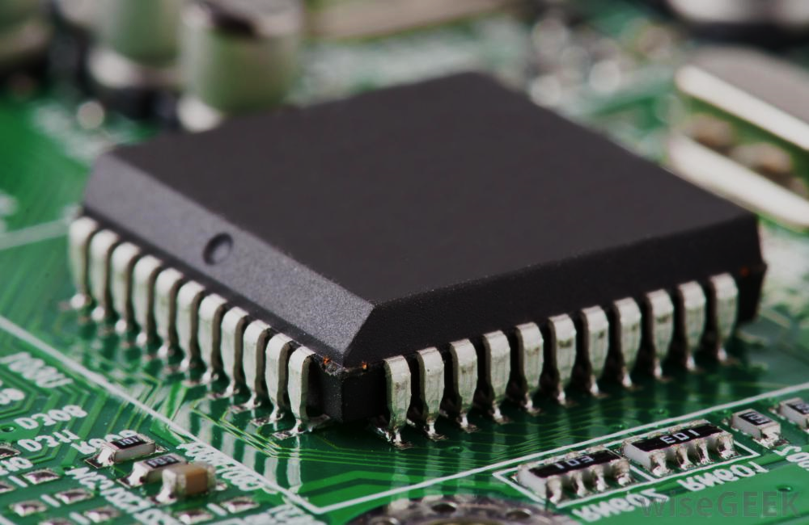
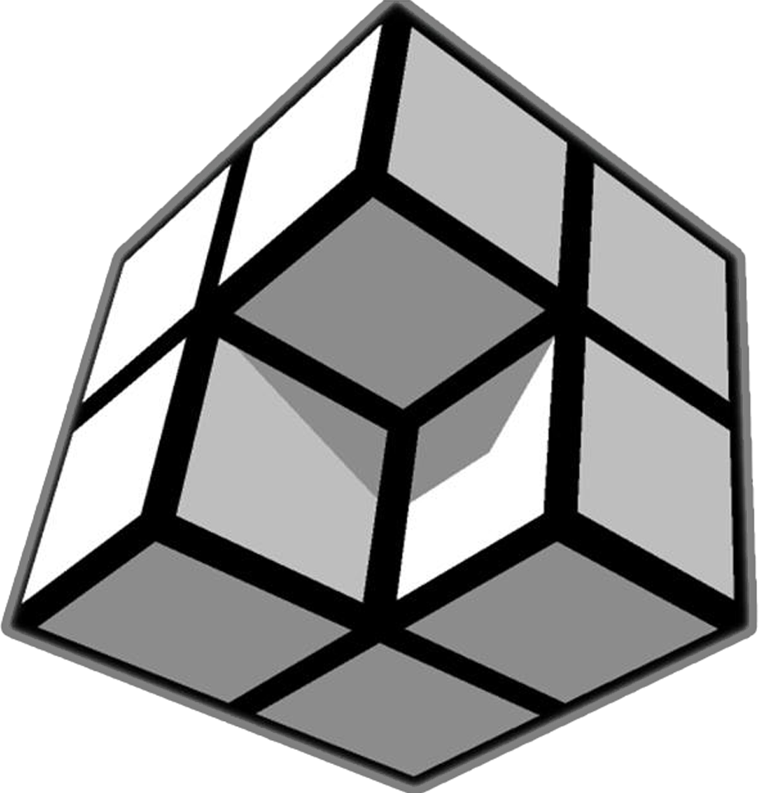
ELECTRONICS
RMI

Slide 2

Let’s Recap
Current: Rate of flow of charges
Voltage(Potential difference between two points): Work done per unit charge in moving it from one point to another.
Resistance: Hindrance to the flow of electric current
Capacitance: Ability of a conductor to store charges

Slide 3
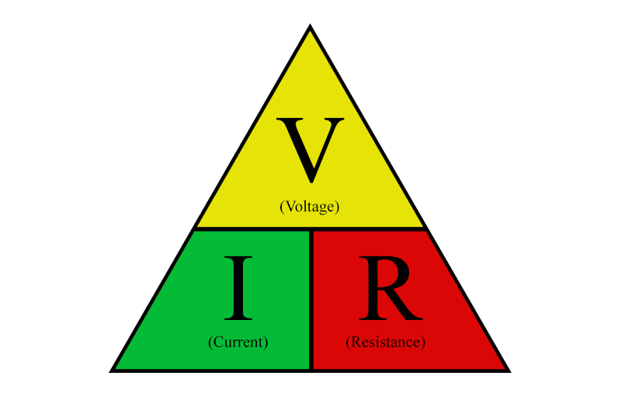
Ohm’s Law
The current flowing through a conductor is directly proportional to the voltage applied across its ends.
V=IR

Slide 4
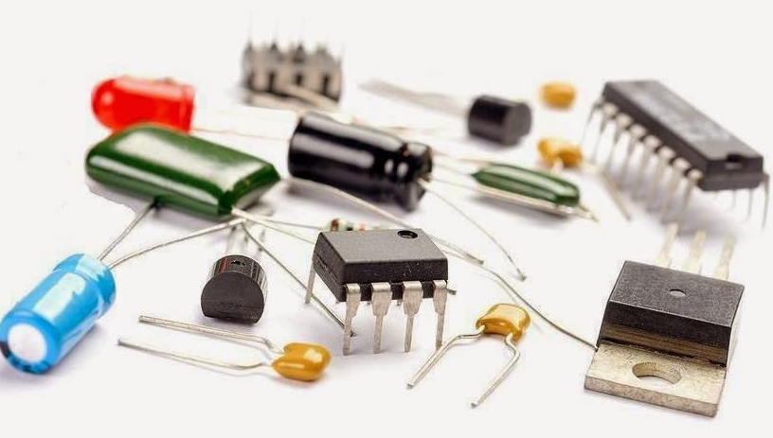
Components

Slide 5
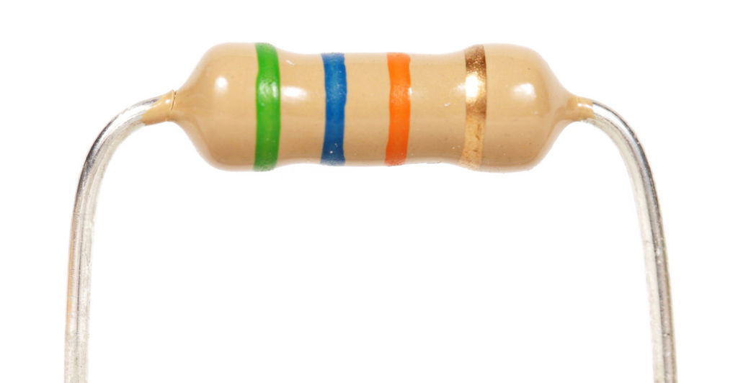
Resistor
Resistors are electronic components which have a specific electrical resistance. The resistor limits the current through a circuit.
Combinations of resistors are also used for voltage division.

Slide 6
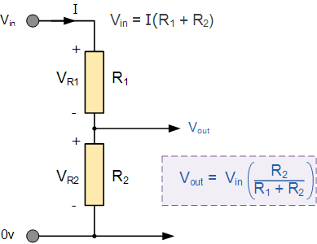
Voltage Divider

Slide 7
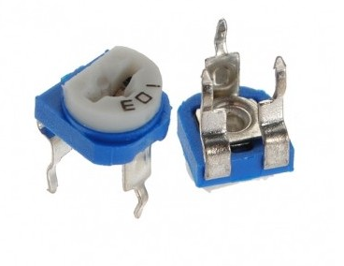
Potentiometer
A potentiometer is basically a potential divider where the ratio of the two resistances can be controlled using a knob.
potentiometers can provide highly precise sensing and measurement for linear or rotary movement as their output voltage is proportional to the wipers position.
It is also used to divide the voltage to the required value.

Slide 8
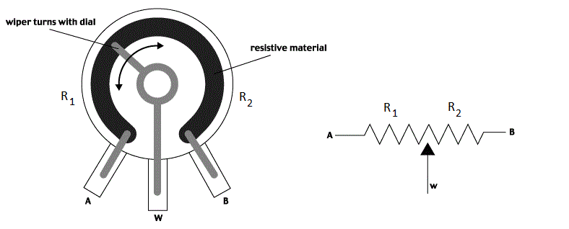
Working of Potentiometer

Slide 9
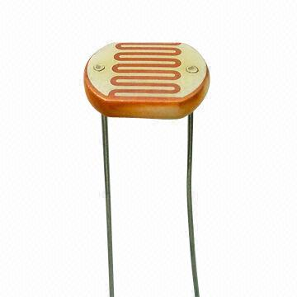
Photoresistor
An LDR (Light dependent resistor), as its name suggests, offers resistance in response to the ambient light.
The resistance decreases as the intensity of incident light increases, and vice versa. In the absence of light, LDR exhibits a very large resistance.
It can act as a sensor, since a varying voltage drop can be obtained in accordance with the varying light.

Slide 10
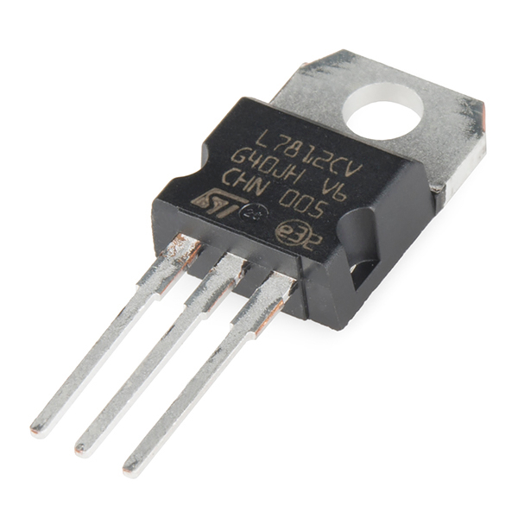
Voltage Regulators
Voltage regulator is a device that maintains the voltage of a power source within acceptable limits(here 5V DC).
Regardless of what kind of load is placed on your circuit, a voltage regulator will always provide a constant, steady output voltage.
Eg: LM-7508 (5v voltage regulator)

Slide 11
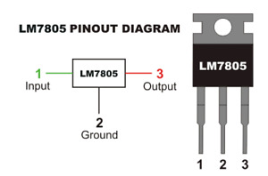
How to use a Voltage Regulator

Slide 12
Why use Voltage Regulator instead of Voltage Divider?

Slide 13
Answer:
If the input voltage to a voltage divider fluctuates, the output voltage fluctuates proportionally.
Even if the input voltage to a Voltage Regulator fluctuates, the output stays relatively constant.

Slide 14
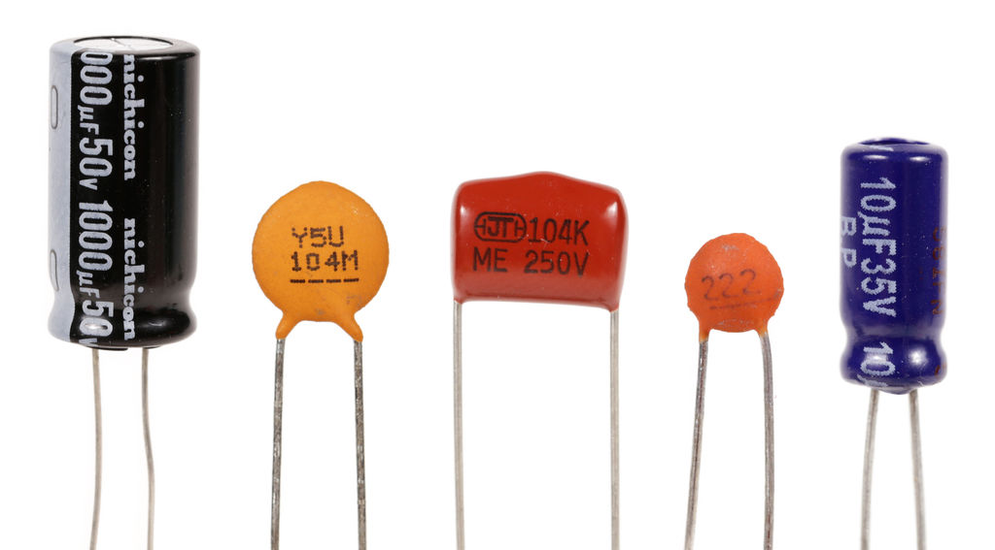
Capacitor
The capacitor is a component which has the ability or “capacity” to store energy in the form of an electrical charge producing a potential difference (Static Voltage) across its plates, much like a small rechargeable battery
It is used to block DC components.

Slide 15
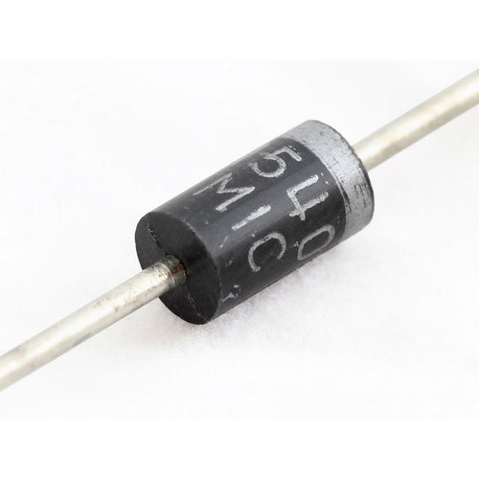
Diode
It is a semiconductor device with two terminals , allowing the flow of current in one direction only.
It has low resistance in one direction and very high resistance in the other.
It is used in rectifiers to convert AC to DC

Slide 16
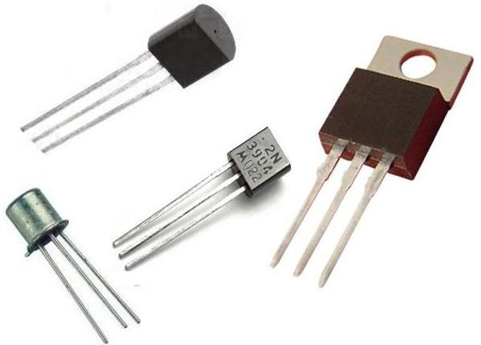
Transistor
A transistor is a semiconductor device used to amplify and switch electronic signals and electrical power respectively. It is composed of semiconductor material and usually has three terminals.

Slide 17
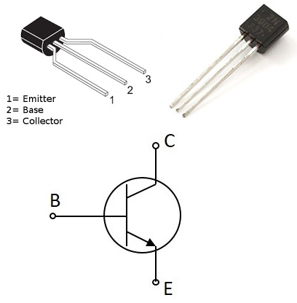
TRANSISTORS
Transistors can be operated as either amplifier or switch.
Amplifier: It takes in a tiny electric current at one end (an input current) and produces a much bigger electric current (an output current) at the other.
Switch: It can be used as an electric switch rather than the conventional mechanical switch. It can switch on and off millions of times per second. This allows it to be used in computers.
While a mechanical switch would require an actuator to be physically flipped, this switch is controlled by the voltage at the base pin.

Slide 18
Classification of Transistors
Transistors
BJT
FET
NPN
PNP
JFET
MOSFET
N-Channel
P-Channel
N-Channel
P-Channel

Slide 19
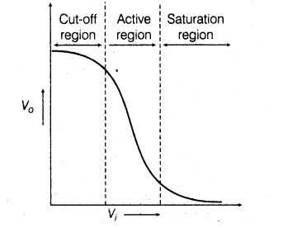
Bipolar Junction Transistor(BJT)
Being a transistor , BJT is used in current amplification and switching action.
It has three terminals:
Emitter (Heavily Doped)
Base (Lightly Doped)
Collector (Moderately Doped)
It has three different regions of operation:
Active Region
Saturation Region
Cut-off Region

Slide 20
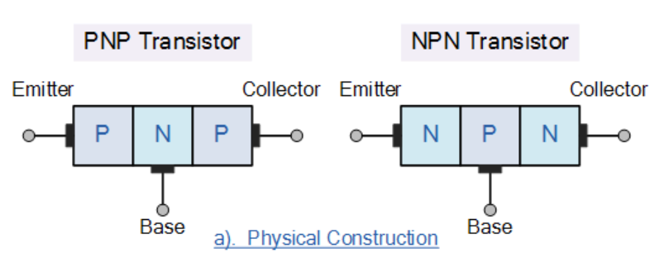
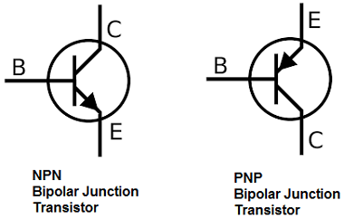
Types of BJT
PNP Transistor- A ‘N’ type semiconductor is sandwiched between two ‘P’ type semiconductors.
NPN Transistor- A ‘P’ type semiconductor is sandwiched between two ‘N’ type semiconductors.
It carries the name bipolar because the current through the transistor is carried both by holes
(positive) and electrons(negative).

Slide 21
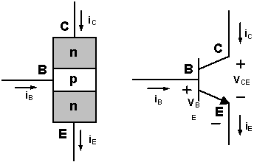
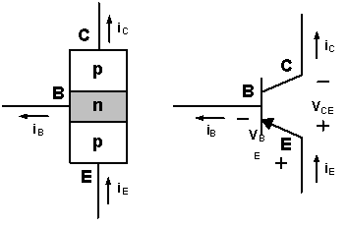
BJT as Current Amplifier
NPN Transistor
Bipolar transistors work as current-controlled current regulators. In other words, transistors control the collector current(output current) with respect to the base current(input current).
The emitter current enters the transistor in case of PNP transistor.
The emitter current exits the transistor in case of NPN transistor.
input current
output current
PNP Transistor
input current
output current

Slide 22
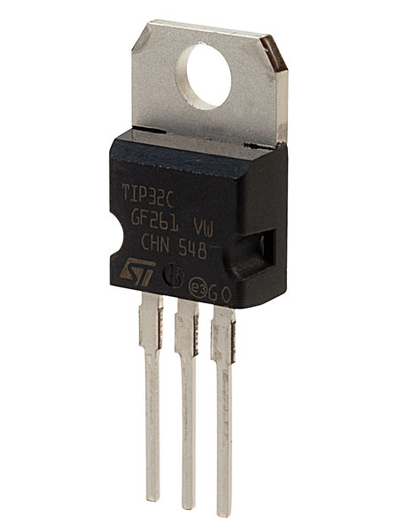
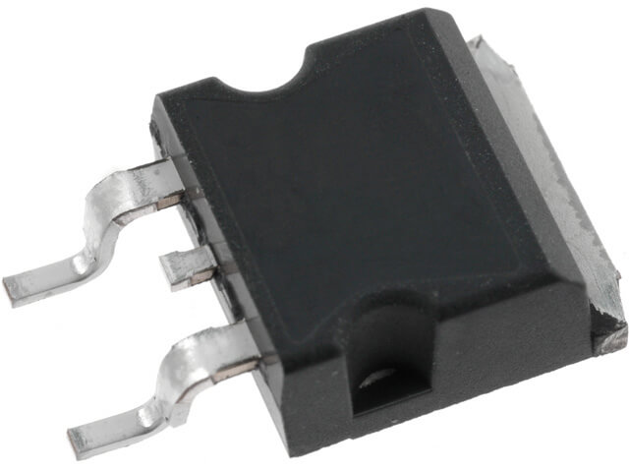
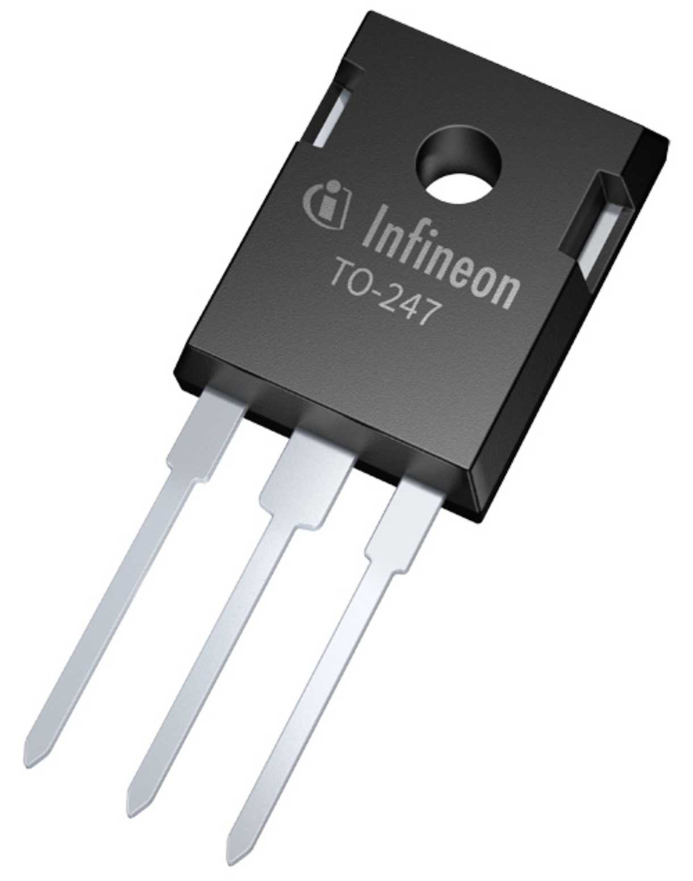
MOSFET
The MOSFET (Metal Oxide Semiconductor Field Effect Transistor) is a semiconductor device which is widely used for switching and amplifying electronic signals in the electronic devices. It as low power loss and high efficiency compared to BJT.
It has three terminals:
Source
Drain
Gate

Slide 23
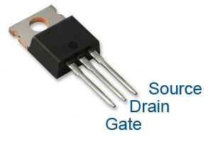
MOSFET
BJTs are current amplifiers whereas MOSFETs are voltage amplifiers.
MOSFETs are Unipolar devices which means the current flows either due to electrons(N-channel MOSFETs) or holes(P-channel MOSFETs).
For N-channel MOSFET, when the voltage at the gate terminal is increased above a threshold value, current starts to flow between the source and drain.

Slide 24
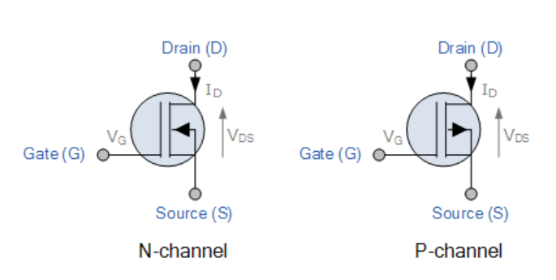
Types of MOSFETS

Slide 25
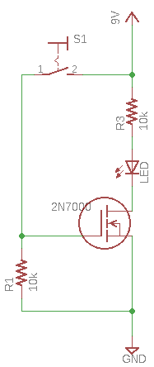
MOSFET as a Switch(N-channel)
When the button is not pressed, resistor R1 pulls the gate voltage to 0V. Therefore no current flows through the source and drain and therefore the LED is off. When the button is pressed, the gate voltage becomes 5V. So, current flows through the source and drain and the LED glows.

Slide 26
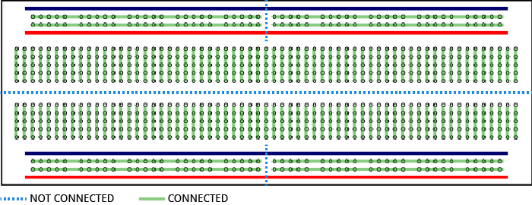
Bread Board

Slide 27
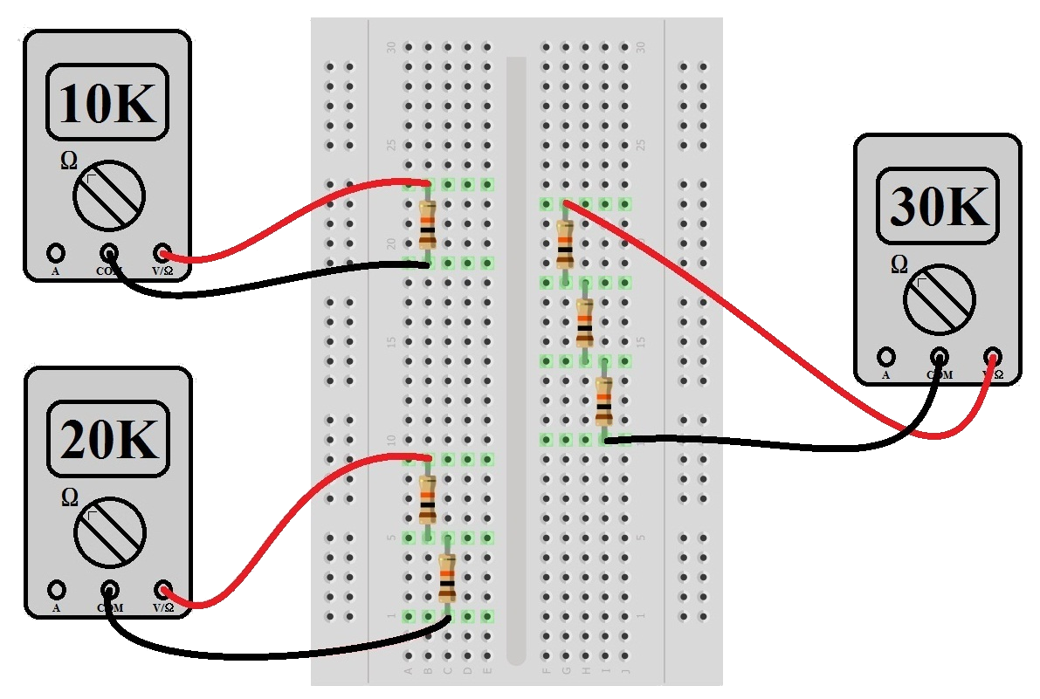
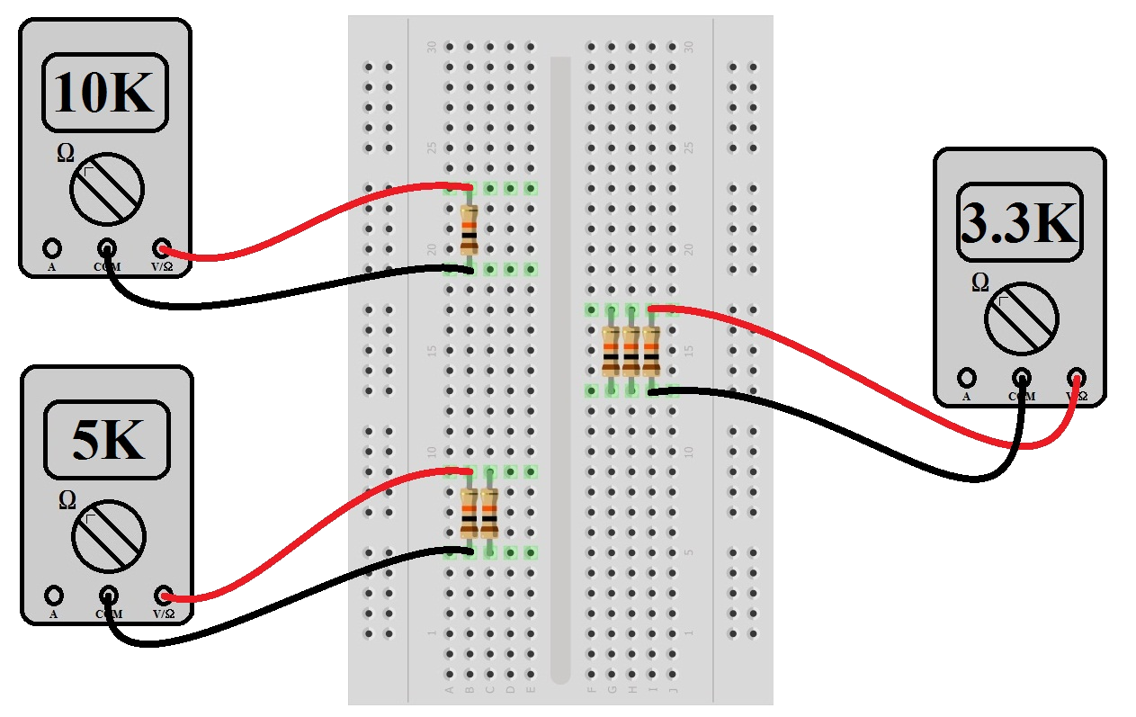
Series and Parallel Connections on Breadboard
Series Connection
Parallel Connection

Slide 28
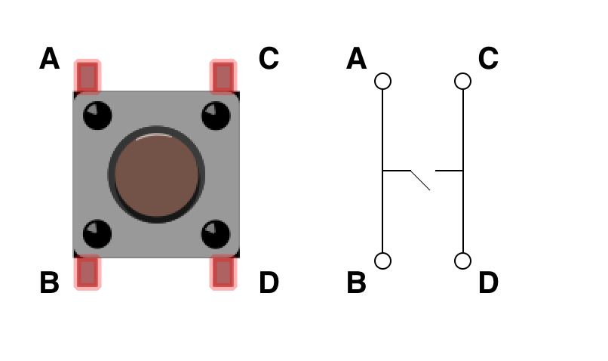
Pushbutton Connection

Slide 29
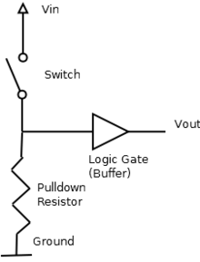
Pull-down Resistor
Pull-down resistors are used in electronic logic circuits to ensure that input settles at logic-0 , if external input is disconnected.
A floating pin picks up noise and interference from the nearby pins. The pull-down resistor dissipates the noises and maintains the potential of the input pin to zero volts (logic-0).

Slide 30
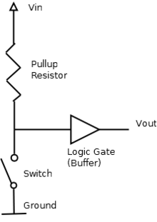
Pull-up Resistor
Pull-up resistors are used in electronic logic circuits to ensure that input settles at logic- HIGH if external input is disconnected.
Just because you have nothing at all connected to an input pin doesn't mean it is at zero volts. It means the input pin is floating somewhere between low and high.

Slide 31
MOSFET as a Switch(N-channel)
When the button is not pressed, resistor R1 pulls the gate voltage to 0V. Therefore no current flows through the source and drain and therefore the LED is off. When the button is pressed, the gate voltage becomes 5V. So, current flows through the source and drain and the LED glows.

Slide 32
Logic Gates using MOSFET

Slide 33
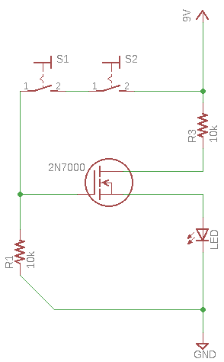
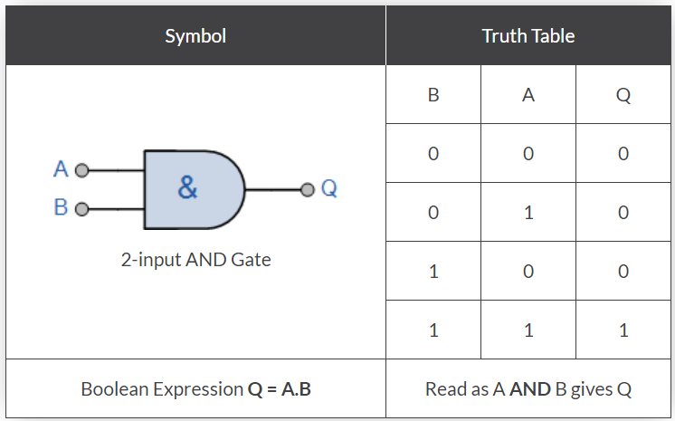
Logic AND
If both the inputs are HIGH then the output is HIGH. Otherwise, the output is LOW.
MOSFET terminal indication,breadboard connections
New circuit

Slide 34
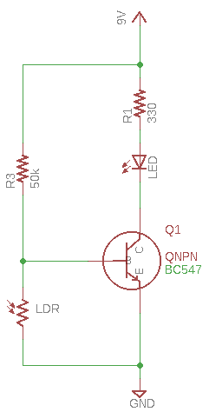
Current Amplification using BJT
The circuit uses LDR as a light sensor.
The resistance of the photoresistor changes according to the lighting thus changing the base current.
The small change in base current gets amplified into a large change in collector current, thus changing the brightness of the LED.

Slide 35

Task
Design OR gate using 2N7000 N-channel MOSFET.

Slide 36


Slide 37
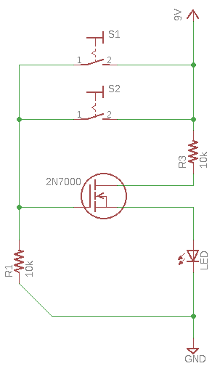
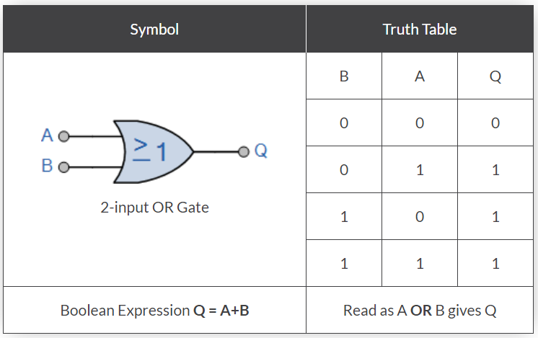
Logic OR
The output of an OR gate is LOW only when all of its inputs are LOW. Otherwise the output is HIGH.

Slide 38
Extras

Slide 39
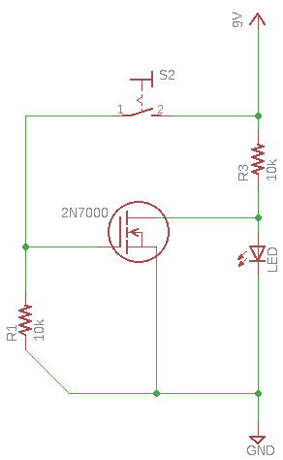
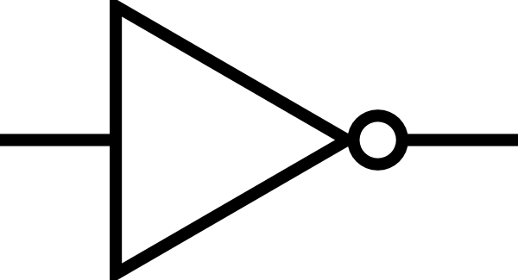
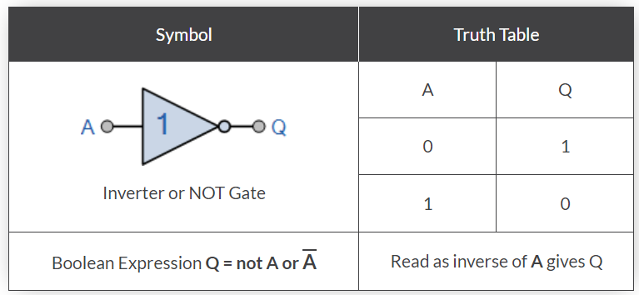
Logic NOT
X
X’
The output is logic-0 if the input is logic-1.
The output is logic-1 if the input is logic-0.

Slide 40
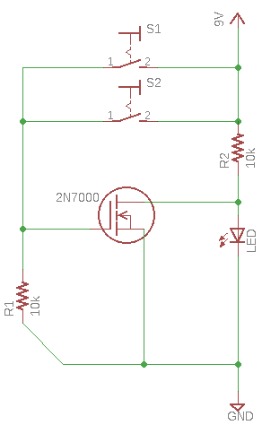
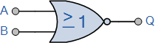
Logic NOR
The output of a NOR gate is HIGH only when all of its inputs are LOW. Otherwise the output is LOW.
Symbol | Truth Table
2-input NOR Gate | B | A | Q
 | 0 | 0 | 1
 | 0 | 1 | 0
 | 1 | 0 | 0
 | 1 | 1 | 0
Boolean Expression Q = A+B | Read as A OR B gives NOT Q

Slide 41
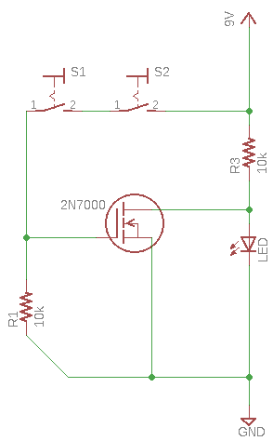
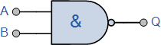
Logic NAND
The output of a NAND gate is LOW only when all of its inputs are HIGH. Otherwise the output is HIGH.
Symbol | Truth Table
2-input NAND Gate | B | A | Q
 | 0 | 0 | 1
 | 0 | 1 | 1
 | 1 | 0 | 1
 | 1 | 1 | 0
Boolean Expression Q = A.B | Read as A AND B gives NOT Q

Slide 42
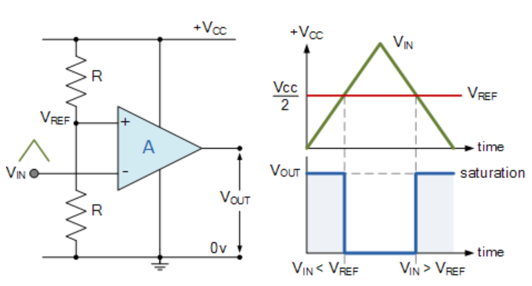
Inverting Comparator Circuit

Slide 43
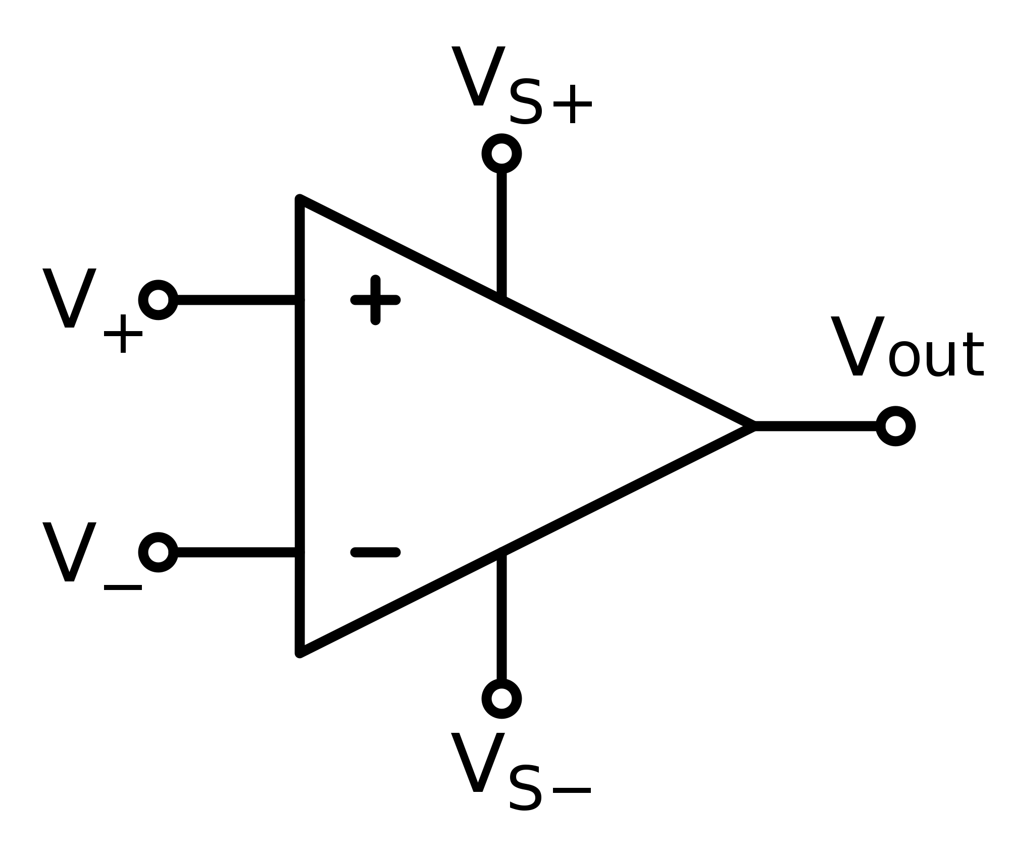
Op-Amp Comparator
The Op-amp comparator compares one voltage level with another voltage level, or some preset reference voltage, V_{REF} and produces an output signal based on this voltage comparison.
If V+ > V- then V_{out} = Vs+
If V+ < V- then V_{out} = Vs-

Slide 44
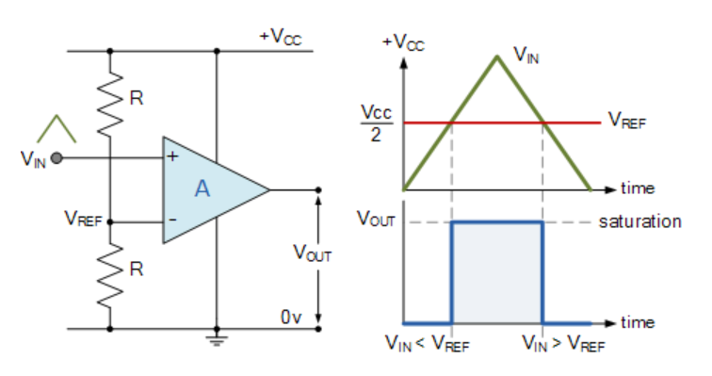
Non-Inverting Comparator Circuit

Slide 45
Operational Amplifier
An Operational Amplifier, or op-amp for short, is fundamentally a voltage amplifier.
It is used in signal filtering, amplification and also to perform mathematical operations such as addition, subtraction, integration and differentiation.
In this session we will use Op-Amp as a Voltage Comparator
Op-Amp has one output and two inputs:
Inverting Input
Non-Inverting Input

